Slide 1
CSE 464 : Software Quality Assurance and Testing
Testing Object Oriented Applications Janaka Balasooriya

Slide 2
Object Oriented Integration Testing

Slide 3
OO Integration Testing
If the class has to be very large, usually a method as a unit can be a viable choice. In that case, two levels of integration testing is required:
  Integrate methods into a class
  Integrate classes into other classes
  On the other hand, if more common, class as a unit is adopted Integrate classes into other classes is required
    Once the unit testing is complete (a) if flatten classes are used, original class hierarchy must be restored.
    Test methods (if any added) must be removed.

Slide 4
Testing Firm Application

Slide 5
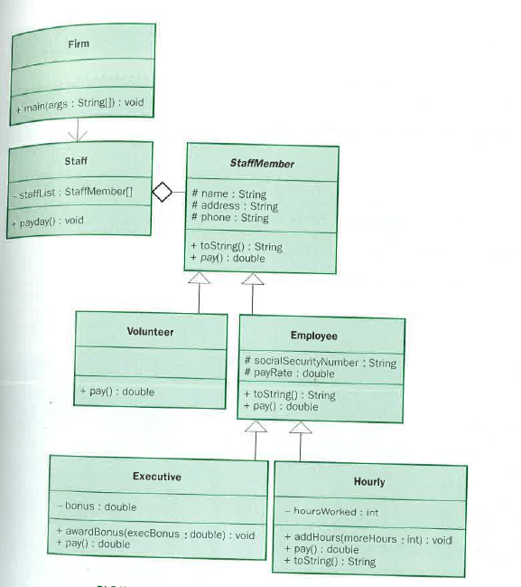
Flattening Objects in Integration Testing
6
5
4
3
1
2

Slide 6
Testing Firm Implementation
One possible approach in testing this application is to test each class starting from the bottom most classes : Hourly and Executive. Then integrate other objects in bottom up manner
Object Flattening can be used here. (See Executive.java example)

Slide 7
Next Time => UML Support for Integration Testing
In OO integration testing, sequence diagrams and collaboration diagrams are the basic for integration testing
Quick Review Sequence Diagram:
  Sequence diagrams describes the dynamic behavior of objects
  It describes interactions between objects by depicting the time ordering. In general each use case has one of more sequence diagrams.

